Slide 1
UBER DATA ANALYSIS
BY : PRIT SUTHAR (20220702156)
SATYAM SHIVAM(20220702070)

Slide 2
AGENDA
01
02
03
04
05
INTRODUCTION
OBJECTIVE
METHODOLOGY & IMPLEMENTATION
CONCLUSION TECHNOLOGIES USED

Slide 3
INTRODUCTION
In this project, We study the data of Uber which is present in tabular format in which we use different libraries like numpy, pandas and matplotlib and different machine learning algorithms. We study
different columns of the table and try to co-relate them with others and find a relation between those two. We try to find and analyze those key factors like date, month, weather, etc which helps Uber Company to
enhance their business by focusing on those services and make required changes.

Slide 4
OBJECTIVE
The objective is to first explore hidden or previously unknown
information by applying exploratory data analytics on the dataset and to know the effect of each field on price with every other field of the dataset. Then we apply different machine learning models to complete the analysis. After this, the results of applied machine learning models were compared and analyzed on the basis of accuracy, and then the
best performing model was suggested for further predictions of the label “Price”.

Slide 5
METHODOLOGY
Data Preparation
Data Visualization Feature Engineering Modelling
Testing
Price Prediction Function

Slide 6
DATA PREPARATION
The data we used for our project was provided on the www.kaggle.com website.
The original dataset contains 693071 rows and 57 columns which contain the data of both Uber and Lyft. But for our analysis, we just need the Uber data so we filter out the data according to our purpose and got a new dataset that has 322844 rows and 56 columns.
The dataset has many fields that describe us about the time, geographic location, and climatic conditions when the different Uber cabs opted.
Data has 3 types of data-types which were as follows:- integer, float, and object.
The dataset is not complete which means we have also null values in a column named price of around 55095.
Dataset
KAGGLE (.csv)
Shape
(322844,56)

Slide 7
EXPLORATORY DATA ANALYSIS
Exploratory Data Analysis refers to the critical process of performing initial investigations on
data so as to discover patterns to spot anomalies to test hypothesis and to check assumptions with the help of summary statistics and graphical representations.
It is a good practice to understand the data first and try to gather as many insights from it. EDA is all about making sense of data in hand.

Slide 8
FEATURE ENGINEERING
All machine learning algorithms use some input data to create outputs. This input data
comprise features, which are usually in the form of structured columns. Algorithms require features with some specific characteristics to work properly and so the need for feature engineering arises.
I think feature engineering efforts mainly have two goals:
Preparing the proper input dataset, compatible with the machine learning algorithm requirements.
Improving the performance of machine learning models.

Slide 9
DATA VISUALIZATION
Data visualization is a graphical representation of information and data. By using visual elements like charts, graphs, and maps, data visualization tools provide an accessible way to see and understand trends, outliers, and patterns in data.

Slide 10
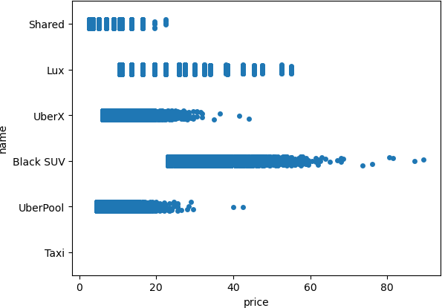
STRIP- PLOT BETWEEN NAME AND PRICE
From this chart, it was clear that Shared trip was cheapest among all and BlackSUV was most expensive.
UberX and UberPool have almost same prices and Lux has moderate price. There is no graph for taxi which reveals that in the dataset there were no values of taxi was given.

Slide 11
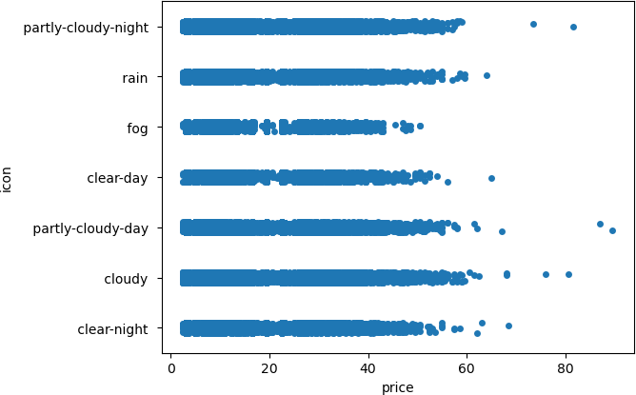
STRIP- PLOT BETWEEN ICON( WEATHER) AND PRICE
From this chart, it was clear there were some outliers in cloudy type weather, some data has an anonymously high price above 80 while the other was below 60. In this plot, we analyze that in cloudy- day weather price was the highest while in foggy weather price was minimum.

Slide 12
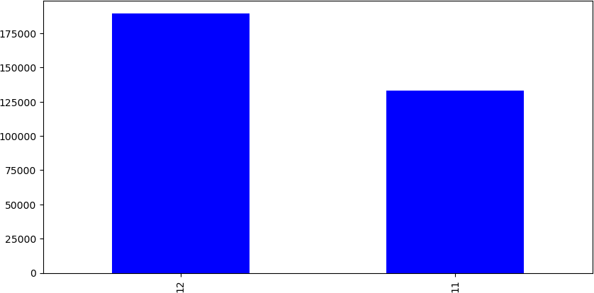
BAR- CHART OF MONTHS
From this bar chart, it was clear that the data consists of all the information of only two months that is November and December.

Slide 13
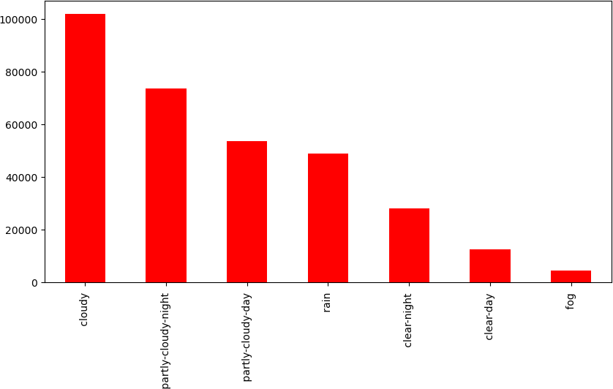
BAR- CHART OF ICONS
The this bar chart represents the value count of the icon column and from the graph, it was clear that cloudy weather has the most data due to which we can say that may be in cloudy weather cab also opted most.

Slide 14
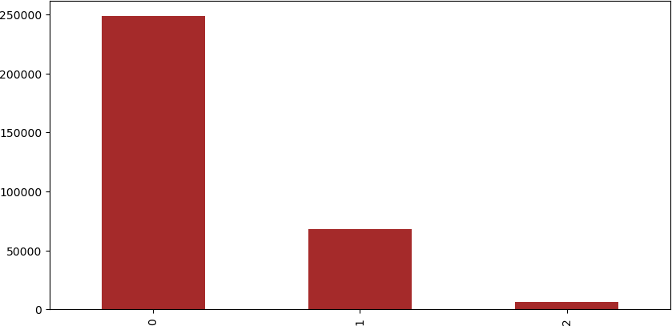
BAR- CHART OF UV- INDEX
The this bar chart represents the value count of the UV-index column and from the graph, it was clear that when UV-index is 0, the dataset has the most data due to which we can say that when there is less UV-index cab was opted most.

Slide 15
LABEL ENCODING
Label Encoding refers to converting the labels into numeric form so as to convert it into the machine-readable form.
Machine learning algorithms can then decide in a better way on how those labels must be operated. It is an important pre- processing step for the structured dataset in supervised learning.

Slide 16
FILLING NAN VALUES
Our data set contain NANs only in Price column.
The count of NANs is: 55095
The NANs is filled with the median of other values.

Slide 17
DROP USELESS FEATURES
After applying RFE we get our 25 best features but still, there are many features which do not affect the price directly so we drop those features according to it. And eight features remained in our dataset.

Slide 18
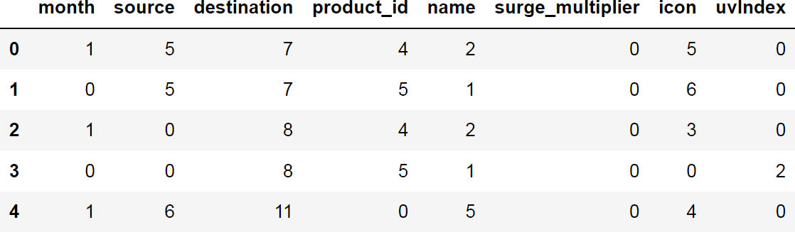
BINNING
Many times we use a method called data smoothing to make the data proper. During this process, we define a range also called bin and any data value within the range is made to fit into the bin. This is called the binning.
Binning is used to smoothing the data or to handle noisy data.
So after dropping useless features, some features are not in range so to make all the features in the same range we apply binning and get our final dataset which is further used for modeling.
FINAL DATASET
FINAL DATASET

Slide 19
MODELLING
The process of modeling means training a machine-learning algorithm to predict the labels from the features, tuning it for the business needs, and validating it on holdout data. When you train an algorithm with data it will become a model.
In this project, we use Scikit-Learn to rapidly implement a few models such as
Linear Regression.

Slide 20
TESTING
The usage of the word "testing" in relation to machine learning models is primarily used for testing the model performance in terms of accuracy/precision of the model.
Mean Squared Error (MSE), Mean Absolute Error (MAE), and Root Mean Squared Error
(RMSE) are used to evaluate the regression problem's accuracy.

Slide 21
Mean Absolute Error (MAE) : It is the mean of all absolute error. MAE (ranges from 0 to infinity, lower is better) is much like RMSE, but instead of squaring the difference of the residuals and taking the square root of the result, it just averages the absolute difference of the residuals. This produces positive numbers only and is less reactive to large errors. MAE takes the average of the error from every sample in a dataset and gives the output.
Mean Squared Error (MSE) : It is the mean of square of all errors. It is the sum, overall the data points, of the square of the difference between the predicted and actual target variables, divided by the number of data points. MSE is calculated by taking the average of the square of the difference between the original and predicted values of the data.
Root Mean Squared Error (RMSE) : RMSE is the standard deviation of the errors which occur when a prediction is made on a dataset. This is the same as MSE (Mean Squared Error) but the root of the value is considered while determining the accuracy of the model. RMSE (ranges from 0 to infinity, lower is better), also called Root Mean Square Deviation (RMSD), is a quadratic-based rule to measure the absolute average magnitude of the error.
In our project, we perform testing on two models: Linear Regression and Random Forest.

Slide 22
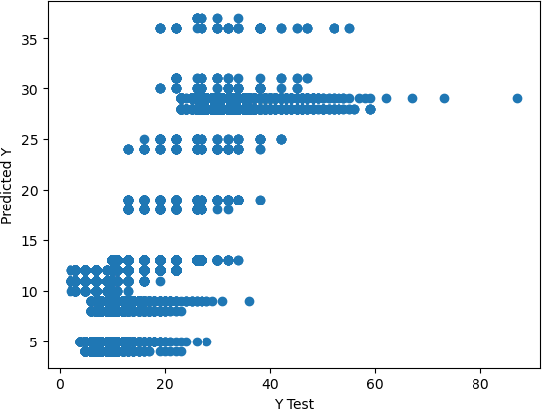
LINEAR REGRESSION MODEL TESTING
We draw a scatter plot between predicted and tested values and then find errors like MSE, MAE, and RMSE.
S. No. | Models | Accuracy
1 | Mean Absolute Error | 3.4060772197184406
2 | Mean Squared Error | 20.033437098297945
3 | Root Mean Squared Error | 4.475872775034825

Slide 23
PRICE PREDICTION FUNCTION
After finding the errors in linear regression, we build a function name “predict_price” whose purpose is to predict the price by taking 4 parameters as input. These four parameters are cab name, source, surge multiplier, and icon (weather).

Slide 24
CONCLUSION
Before working on features first we need to know about the data insights which we get to know by EDA.
Apart from that, we visualize the data by drawing various plots, due to which we understand that we don’t have any data for taxi’s price, also the price variations of other cabs and different types of weather.
Other value count plots show the type and amount of data the dataset has.
After this, we convert all categorical values into continuous data type and fill price Nan by the median of other values.
Then the most important part of feature selection came which was done with the help of recursive feature elimination.
With the help of RFE, the top 25 features were selected. Among those 25 features still, there are some features which we think are not that important to predict the price so we drop them and left with 8 important columns.
We apply four different models on our remaining dataset among which Decision Tree, Random Forest, and Gradient Boosting Regressor prove best with 96%+ accuracy on training for our model.
This means the predictive power of all these three algorithms in this dataset with the chosen features is very high but in the end, we go with random forest because it does not prone to overfitting and design a function with the help of the same model to predict the price.

Slide 25





TECHNOLOGIES USED

Slide 26
THANK YOU!

